Slide 1

GIT

Slide 2

Source Code Manager (SCM)
A source code manager (SCM) is a software tool used to track revisions in software.
As teams design, develop and deploy software, it is common for multiple versions of the same software to be deployed in different sites and for the software's developers to be working simultaneously on updates
Source Control Management (SCM) is more than just a tool for developers to use for collaboration in development.
Git
Mercurial
SVN
Approved source code management systems should include the following features:
Authenticated access for commits
Revision history on files
Atomic commits of multiple files
Versioning/Tagging

Slide 3

Why Is Version Control Important?
Single Source of Truth
Code Collaboratively
Storing Versions
Restoring Previous Versions
Backup
Develop Remotely
Manage Users
File-Level Permissions
Traceability
Reduced duplication
Do DevOps Right

Slide 4

Types of VCS
Following are the types of VCS:
Centralized version control system (CVCS).
Distributed/Decentralized version control system (DVCS).
Centralized version control system (CVCS) uses a central server to store all files and enables team collaboration. But the major drawback of CVCS is its single point of failure, i.e., failure of the central server. Unfortunately, if the central server goes down for an hour, then during that hour, no one can collaborate at all. Example SVN
Distributed version control system(DVCS) clients not only check out the latest snapshot of the directory but they also fully mirror the repository. If the server goes down, then the repository from any client can be copied back to the server to restore it.
Git does not rely on the central server and that is why you can perform many operations when you are offline.
You can commit changes, create branches, view logs, and perform other operations when you are offline.
You require network connection only to publish your changes and take the latest changes.

Slide 5

Advantages of Git
Free and open source
Git is released under GPL’s open source license. It is available freely over the internet.
Fast and small
As most of the operations are performed locally, it gives a huge benefit in terms of speed
Implicit backup
The chances of losing data are very rare when there are multiple copies of it.
Security
Git uses a common cryptographic hash function called secure hash function (SHA1)
No need of powerful hardware
In case of CVCS, the central server needs to be powerful enough to serve requests of the entire team
Easier branching
branch management with Git is very simple. It takes only a few seconds to create, delete, and merge branches.

Slide 6

GIT/DVCS Terminologies
Working Directory
Git Add
Commit
Staging Area or Index
Push
You modify a file from the working directory
Git
Remote repository
You add these files to the staging area.
stores the changes permanently to the Git repository

Slide 7

GIT/DVCS Terminologies
Blobs
Blob stands for Binary Large Object. Each version of a file is represented by blob
Trees
Tree is an object, which represents a directory
Commits
Commit holds the current state of the repository. A commit is also named by SHA1 hash
Branches
Branches are used to create another line of development
Clone
Clone operation creates the instance of the repository
Pull
Pull operation copies the changes from a remote repository instance to a local one
Push
Push operation copies changes from a local repository instance to a remote one
HEAD
HEAD is a pointer, which always points to the latest commit in the branch

Slide 8

GIT Life Cycle
Repository
Working Copy
Clone operation
Edit, Add, Move files
Update operation
Modify working copy
Status and Diff operation
Review changes
Commit and Push operation
Push operation
Commit changes
Amend and Push operation
Push operation
Fix mistakes

Slide 9

GIT Branching and Merging
Branch
Branch operation allows creating another line of development.
We can use this operation to fork off the development process into two different directions.
For example, we released a product for 6.0 version and we might want to create a branch so that the development of 7.0 features can be kept separate from 6.0 bug fixes.
Merge
Merging is Git's way of putting a forked history back together again.
The git merge command lets you take the independent lines of development created by git branch and integrate them into a single branch.

Slide 10

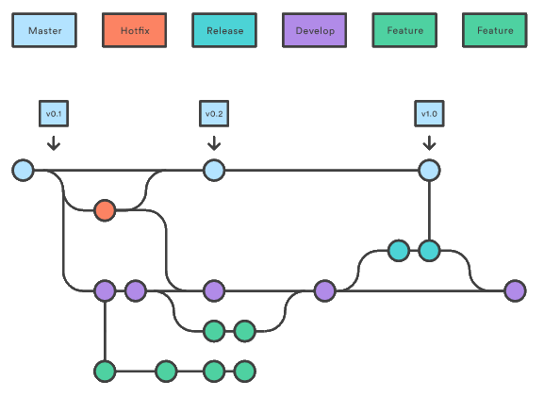
GIT Branching and Merging

Slide 11

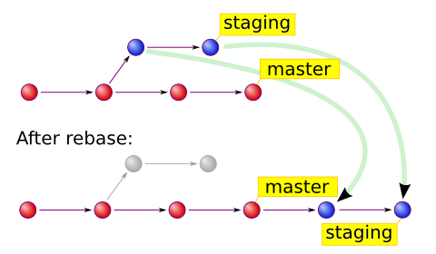
GIT rebase
The Git rebase command is a branch merge command, but the difference is that it modifies the order of commits.
The Git merge command tries to put the commits from other branches on top of the HEAD of the current local branch.
For example, your local branch has commits A−>B−>C−>D and the merge branch has commits A−>B−>X−>Y, then git merge will convert the current local branch to something like A−>B−>C−>D−>X−>Y

Slide 12

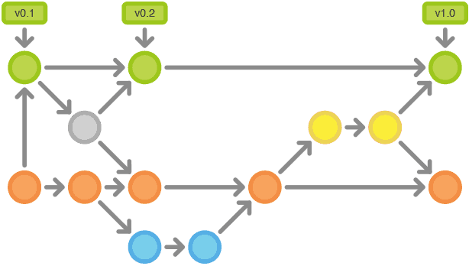
GIT Tag
Tag operation allows giving meaningful names to a specific version in the repository

Slide 13

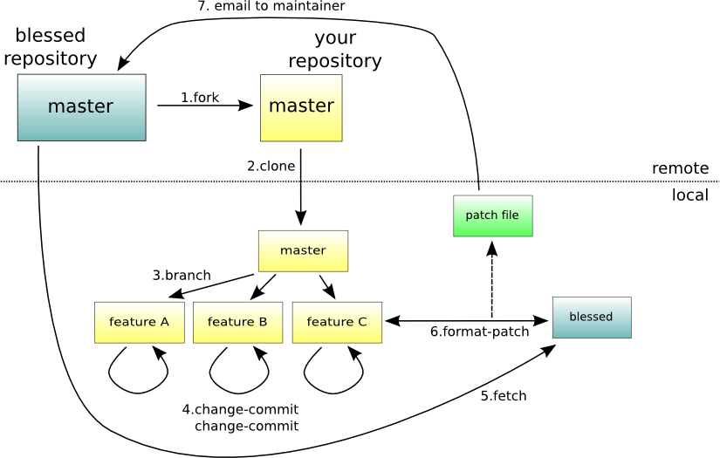
GIT Patch
Patch is a text file, whose contents are similar to Git diff, but along with code, it also has metadata about commits; e.g., commit ID, date, commit message, etc. We can create a patch from commits and other people can apply them to their repository.

Slide 14

GIT Stash
Suppose you are implementing a new feature for your product. Your code is in progress and suddenly a customer escalation comes. Because of this, you have to keep aside your new feature work for a few hours.
You cannot commit your partial code and also cannot throw away your changes. So you need some temporary space, where you can store your partial changes and later on commit it.
In Git, the stash operation takes your modified tracked files, stages changes, and saves them on a stack of unfinished changes that you can reapply at any time
Git Repository
2-- Pull / fetch fix the issue and push
Working Directory
1 – git stash
stash
3 – git stash pop

